Slide 1
Dependency Injection(DI) With Hilt/Dagger
mahbub.kuet@gmail.com
https://www.linkedin.com/in/iamcrypticcoder

Slide 2
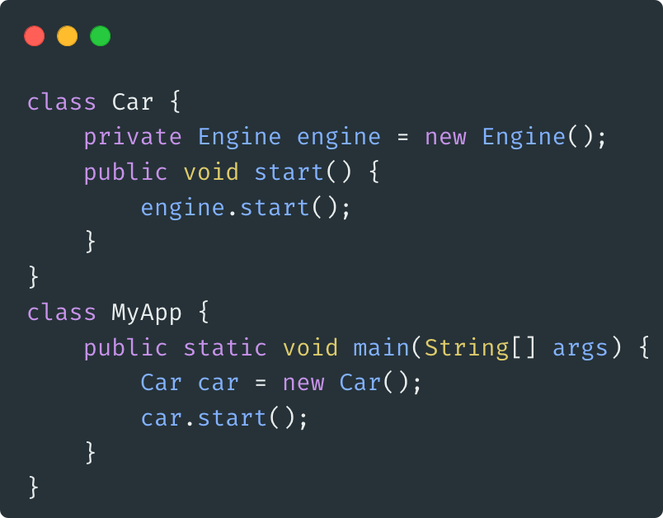
What is Dependency Injection (DI)
Dependency Injection is a design pattern that allows you to remove hard-coded dependencies between objects and make them more flexible and easier to test. Dependency injection is based on the Inversion of Control principle in which generic code controls the execution of specific code.
Dependency injection provides you below benefits:
Reusability of code
Ease of refactoring
Ease of testing
Dependency injection (DI) is a technique widely used in programming and many framework adopt dependency injection default and push developers to use it. Example: Spring Boot Framework.
An example of dependency in your code shown at the right side.

Slide 3
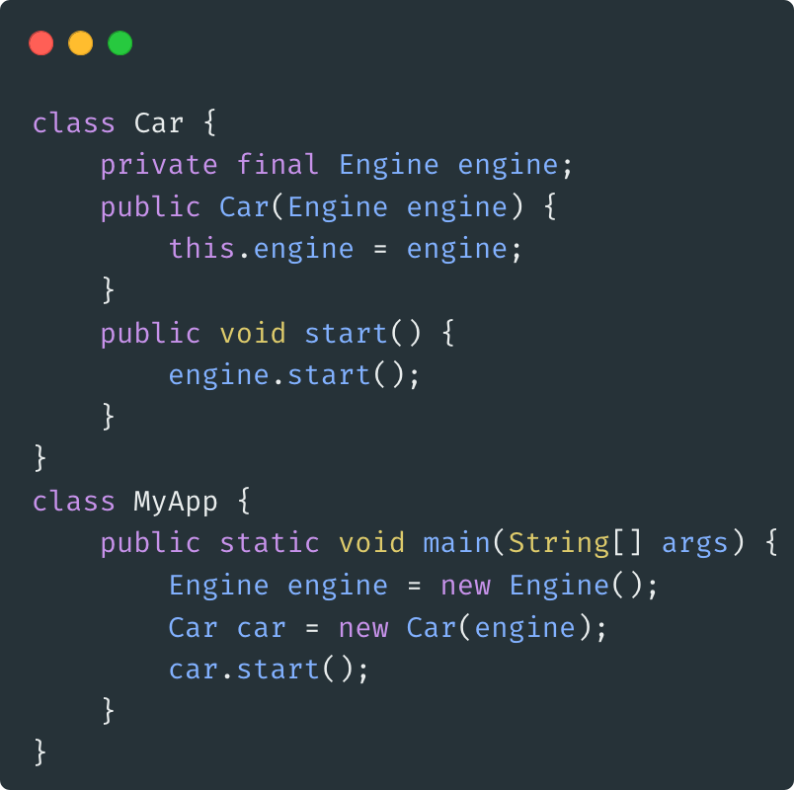
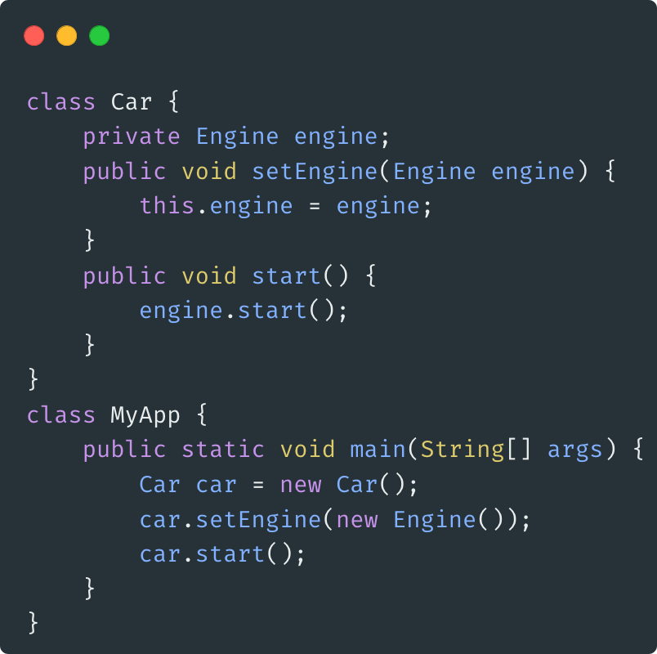
Dependency in your code
Pass dependency in constructor
Pass dependency via setter

Slide 4
Automated Dependency Injection
Problems with manual dependency injection:
A lot of boilerplate code is required to do proper DI in large projects.
You must write and maintain your own dedicated container that manages lifecycle of your app.
Solution with dependency injection library:
A library that automates the process of generating and providing dependencies
Reflection based solution that injects dependencies at runtime
A static solution generates code to link dependencies at compile time.
Dagger from Google is widely used as DI for Java, Kotlin and Android.
Dagger solves performance issues of reflection based solution (e.g Guice) with fully static compile-time DI

Slide 5
Key Concepts in Dependency Injection
Dependencies: The objects or services that a class needs in order to function.
Injector: A class or component responsible for creating instances and injecting dependencies into objects.
Inversion of Control (IoC): The process of transferring the control of object creation from the class itself to an external entity (the DI container).

Slide 6
Types of Dependency Injection
Constructor Injection: Dependencies are provided through the constructor.
Field Injection: Dependencies are injected directly into fields of a class.
Method Injection: Dependencies are injected via setter methods or other methods.

Slide 7
Hilt in Android
Hilt is Jetpack’s recommended libraries for Android Dependency Injection.
Hilt is built on top of the popular DI library Dagger.
Provides standard containers for Android classes (Activity, Fragment, etc.)
Apply DI by automatically managing the lifecycle.
Stable version released from April 2022.
Compile-time correctness, Runtime performance and scalability
Reduced boilerplate code (less code from developer end)
Android studio support to dagger provides

Slide 8
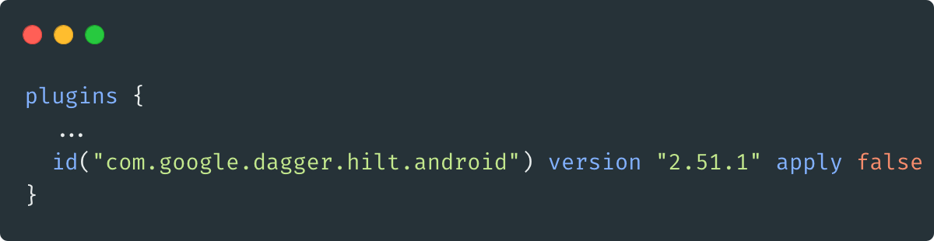
Hilt - Setup - Step 1
First, add the hilt-android-gradle-plugin plugin to your project's root build.gradle file:
plugins { ... id("com.google.dagger.hilt.android") version "2.51.1" apply false }

Slide 9
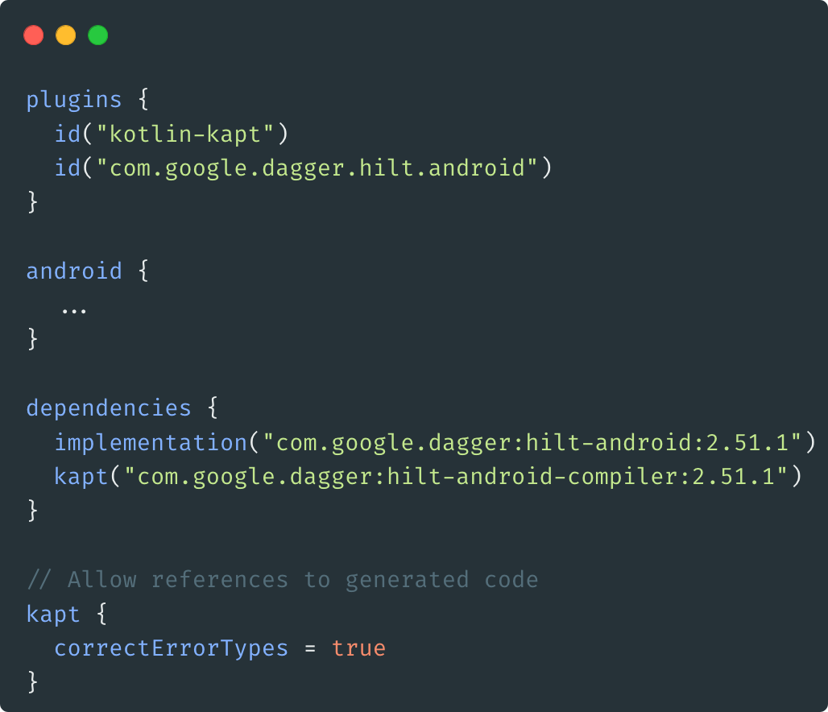
Hilt - Setup - Step 2
Then, apply the Gradle plugin and add these dependencies in your app/build.gradle file:
plugins { id("kotlin-kapt") id("com.google.dagger.hilt.android") } android { ... } dependencies { implementation("com.google.dagger:hilt-android:2.51.1") kapt("com.google.dagger:hilt-android-compiler:2.51.1") } // Allow references to generated code kapt { correctErrorTypes = true }

Slide 10
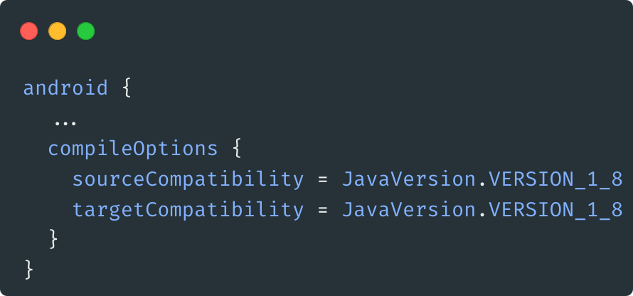
Hilt - Setup - Step 3
Hilt uses Java 8 features. To enable Java 8 in your project, add the following to the app/build.gradle file:
android { ... compileOptions { sourceCompatibility = JavaVersion.VERSION_1_8 targetCompatibility = JavaVersion.VERSION_1_8 } }

Slide 11
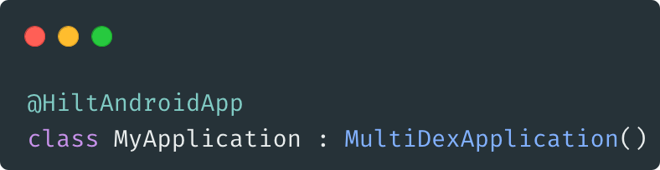
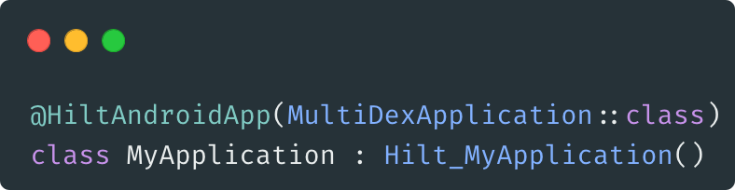
Hilt - Setup - Step 4
All apps that use Hilt must contain an Application class that is annotated with @HiltAndroidApp. @HiltAndroidApp triggers Hilt's code generation, including a base class for your application that serves as the application-level dependency container.
With Gradle Plugin
Without Gradle Plugin
Ref: https://developer.android.com/training/dependency-injection/hilt-android

Slide 12
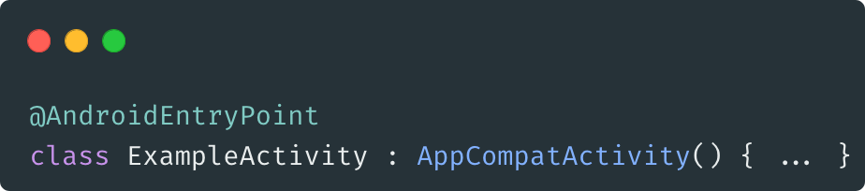
Hilt - @AndroidEntryPoint
Once Hilt is setup in your Application class and an application-level component is available, Hilt can provide dependencies to other Android classes that have the @AndroidEntryPoint annotation:

Slide 13
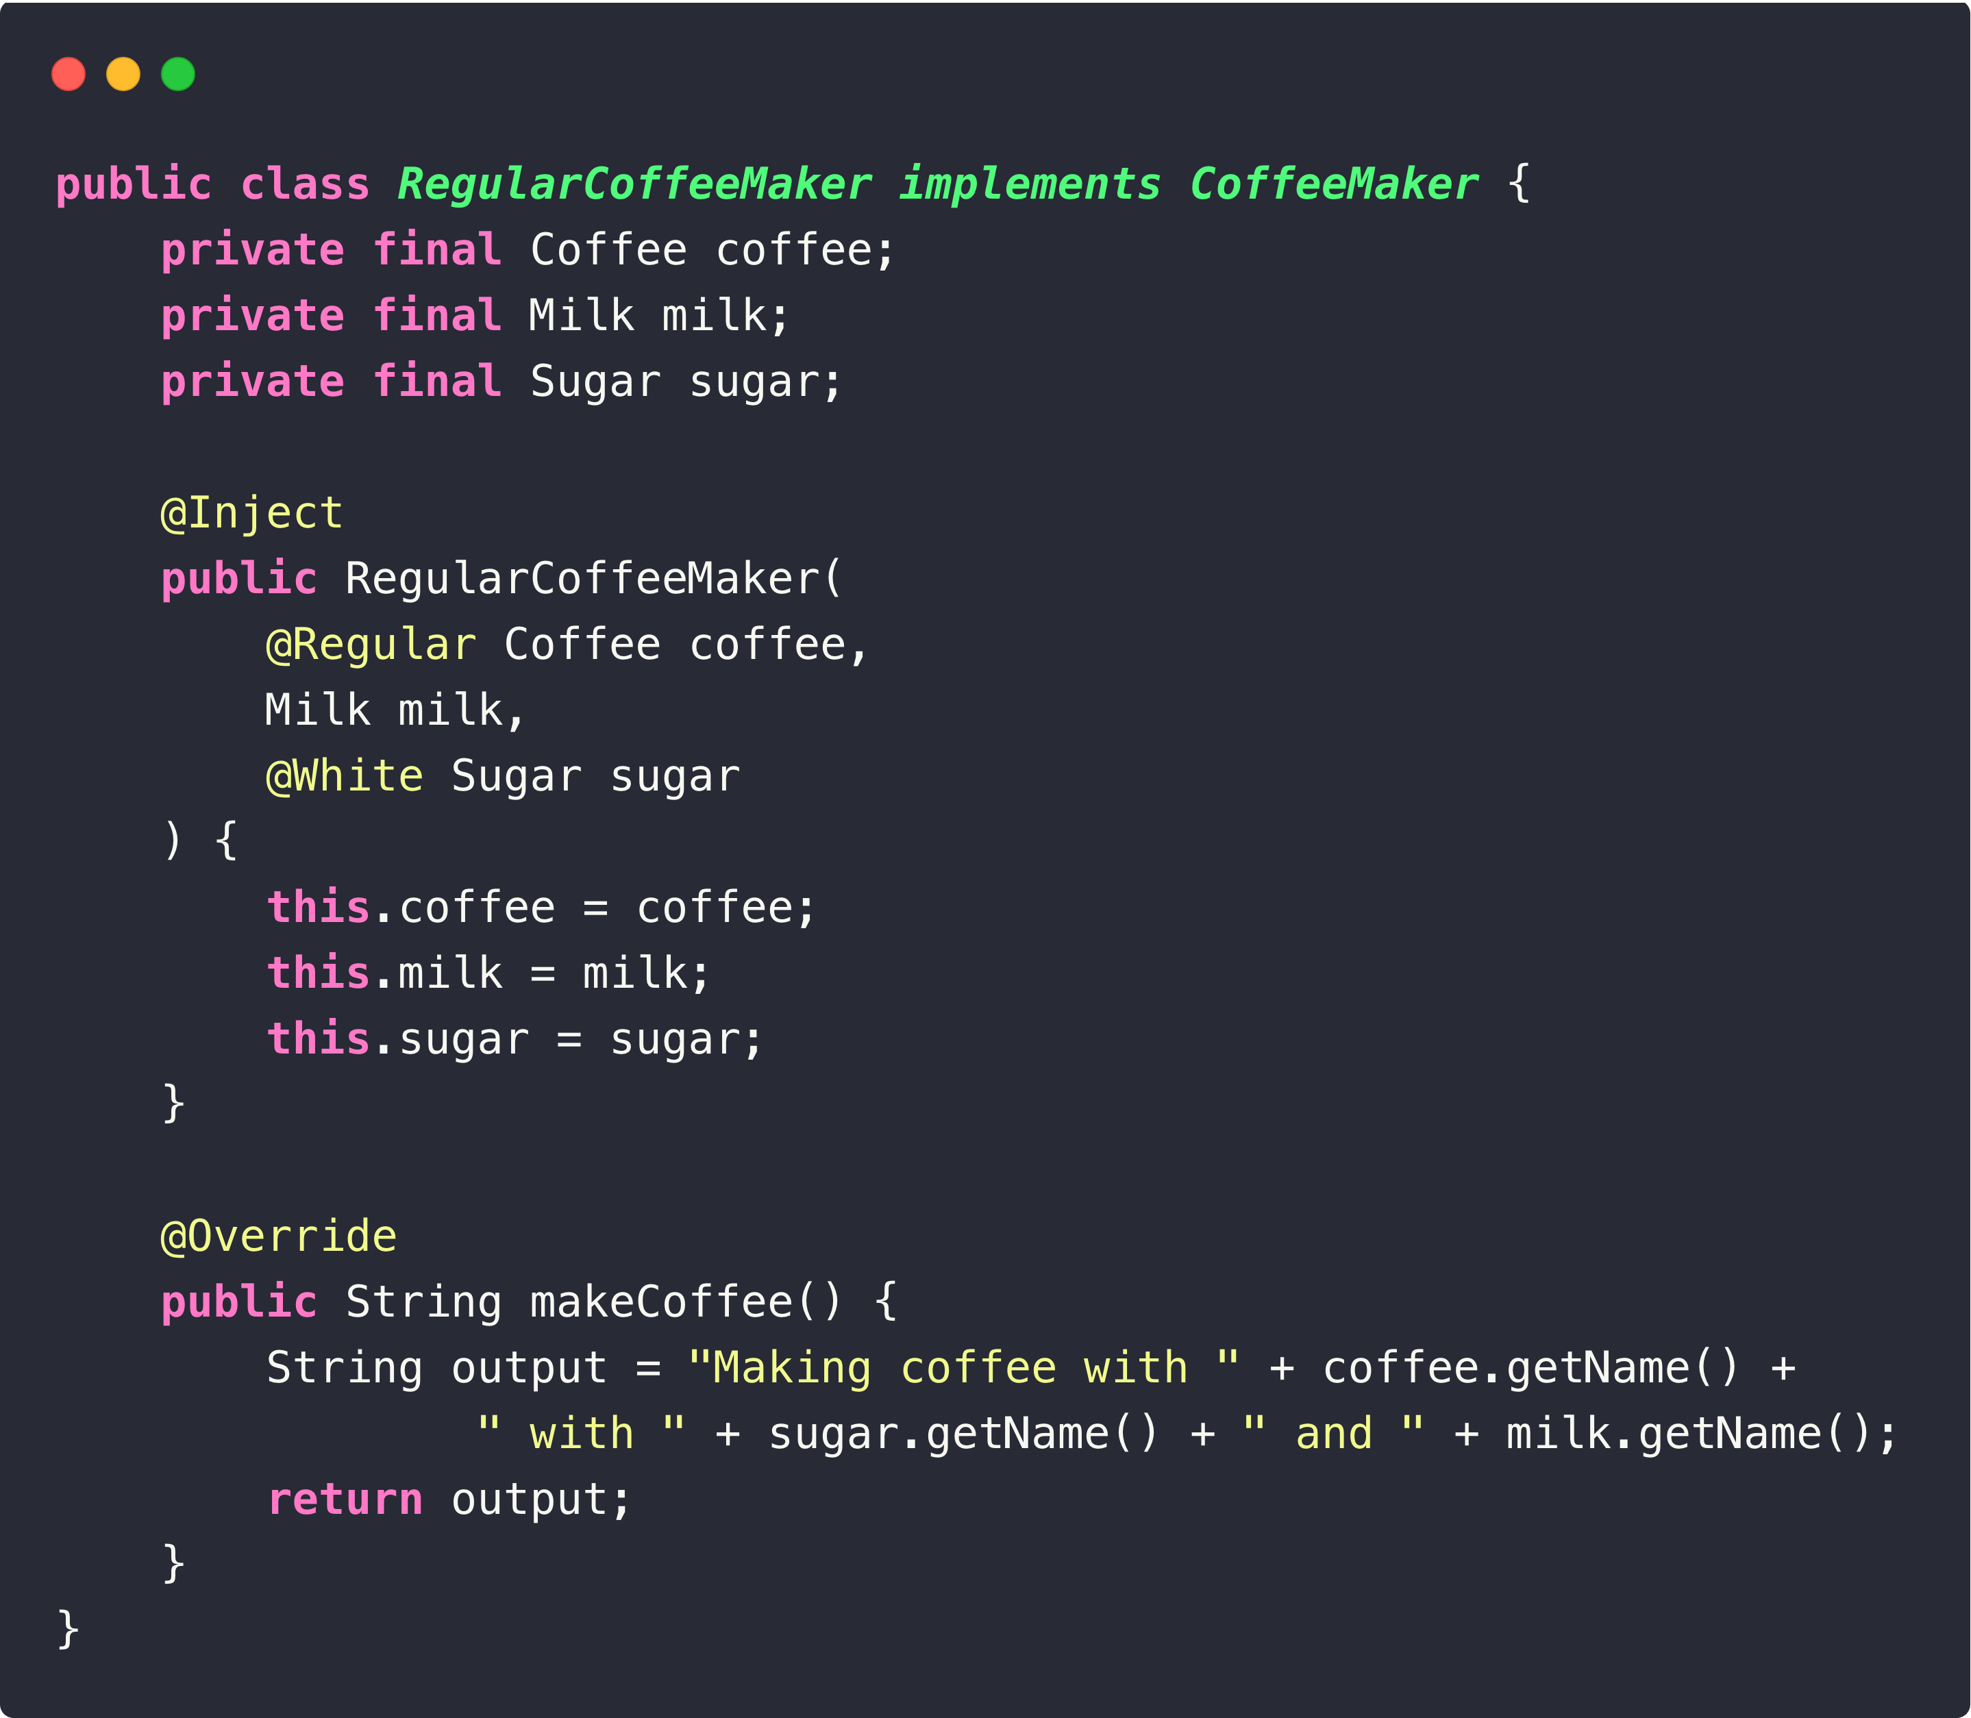
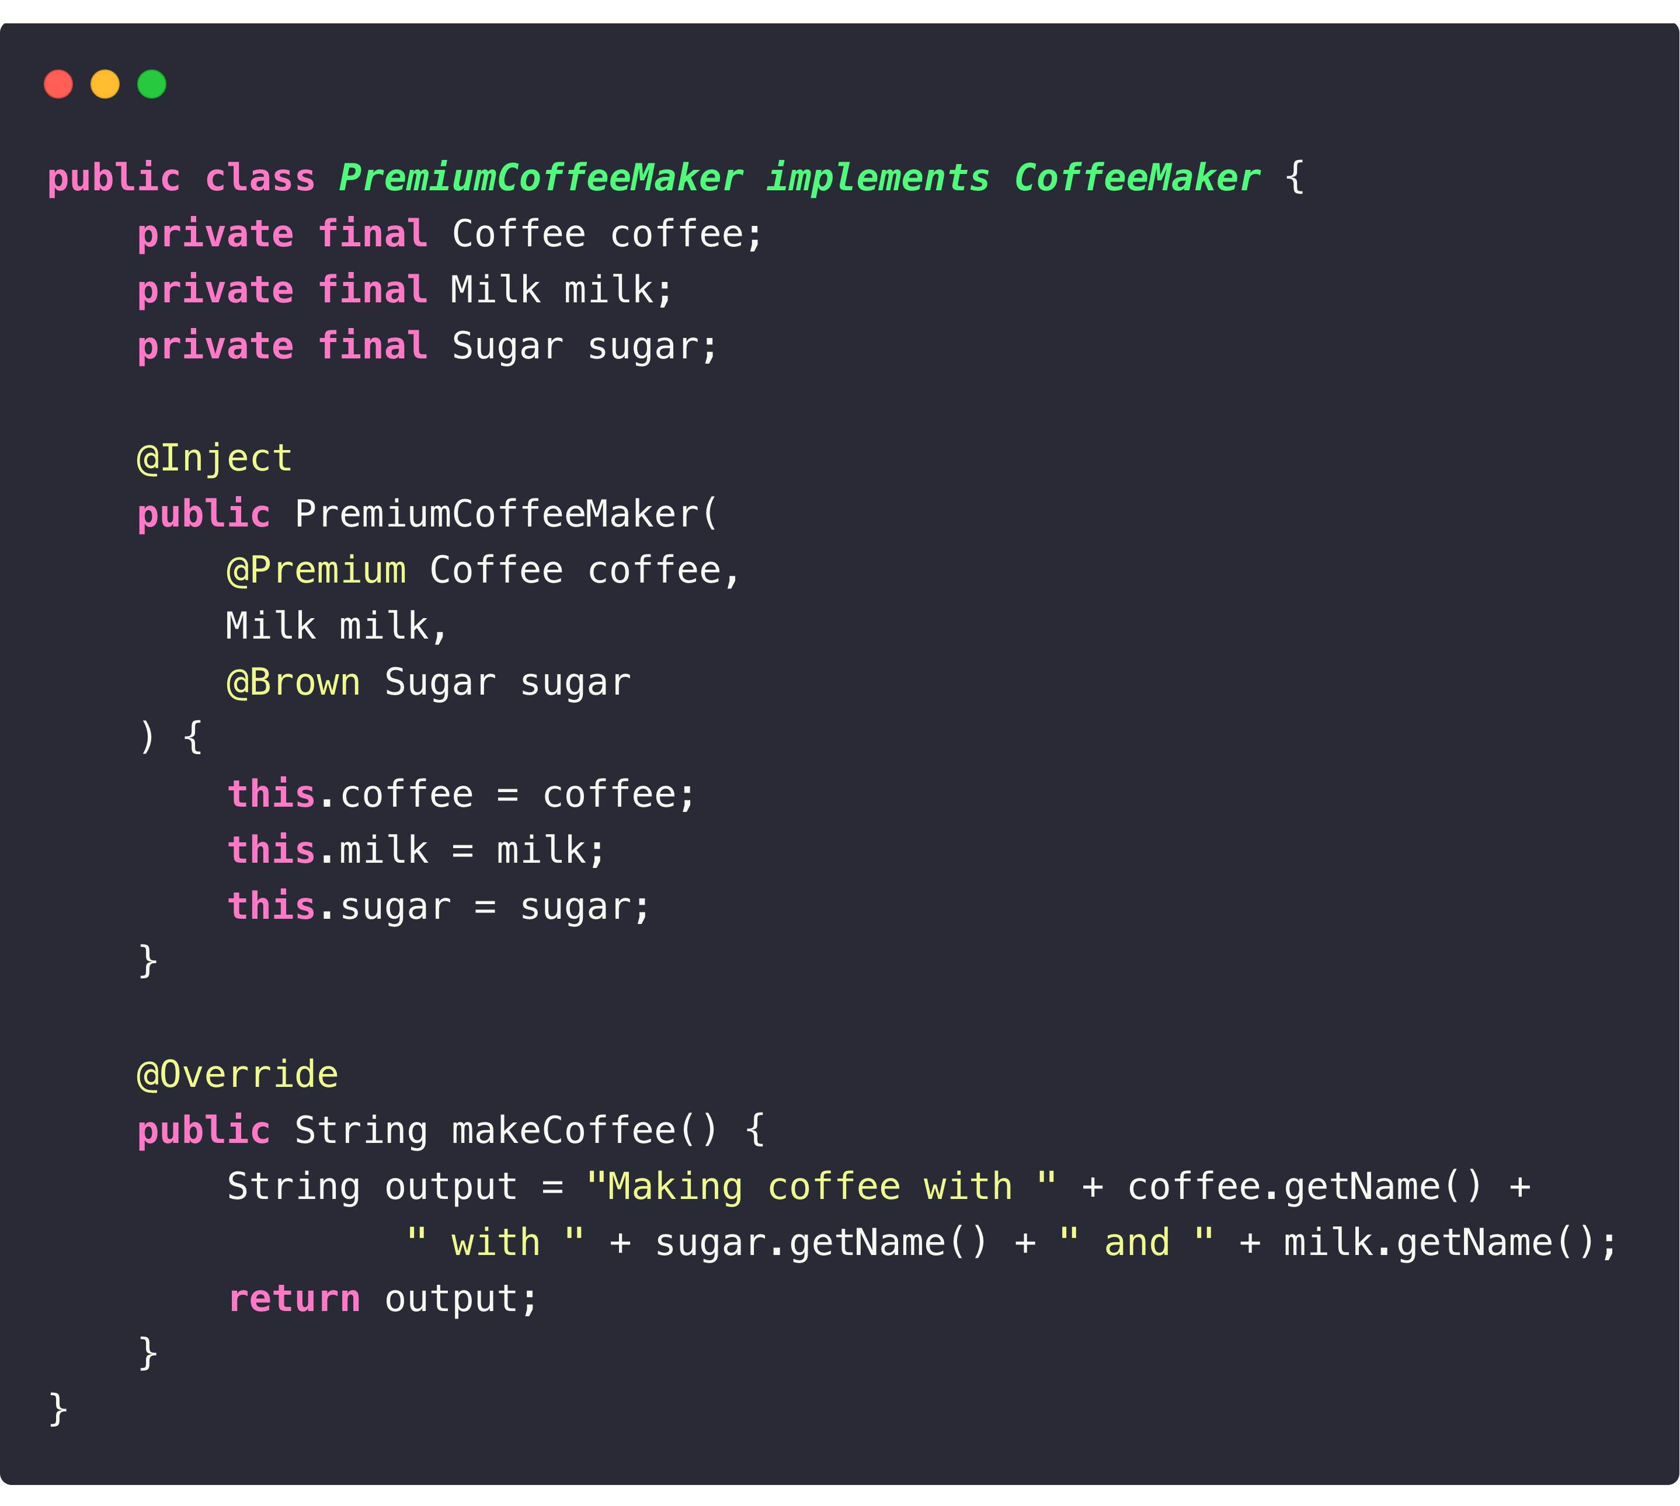
Hilt - Constructor Injection

Slide 14
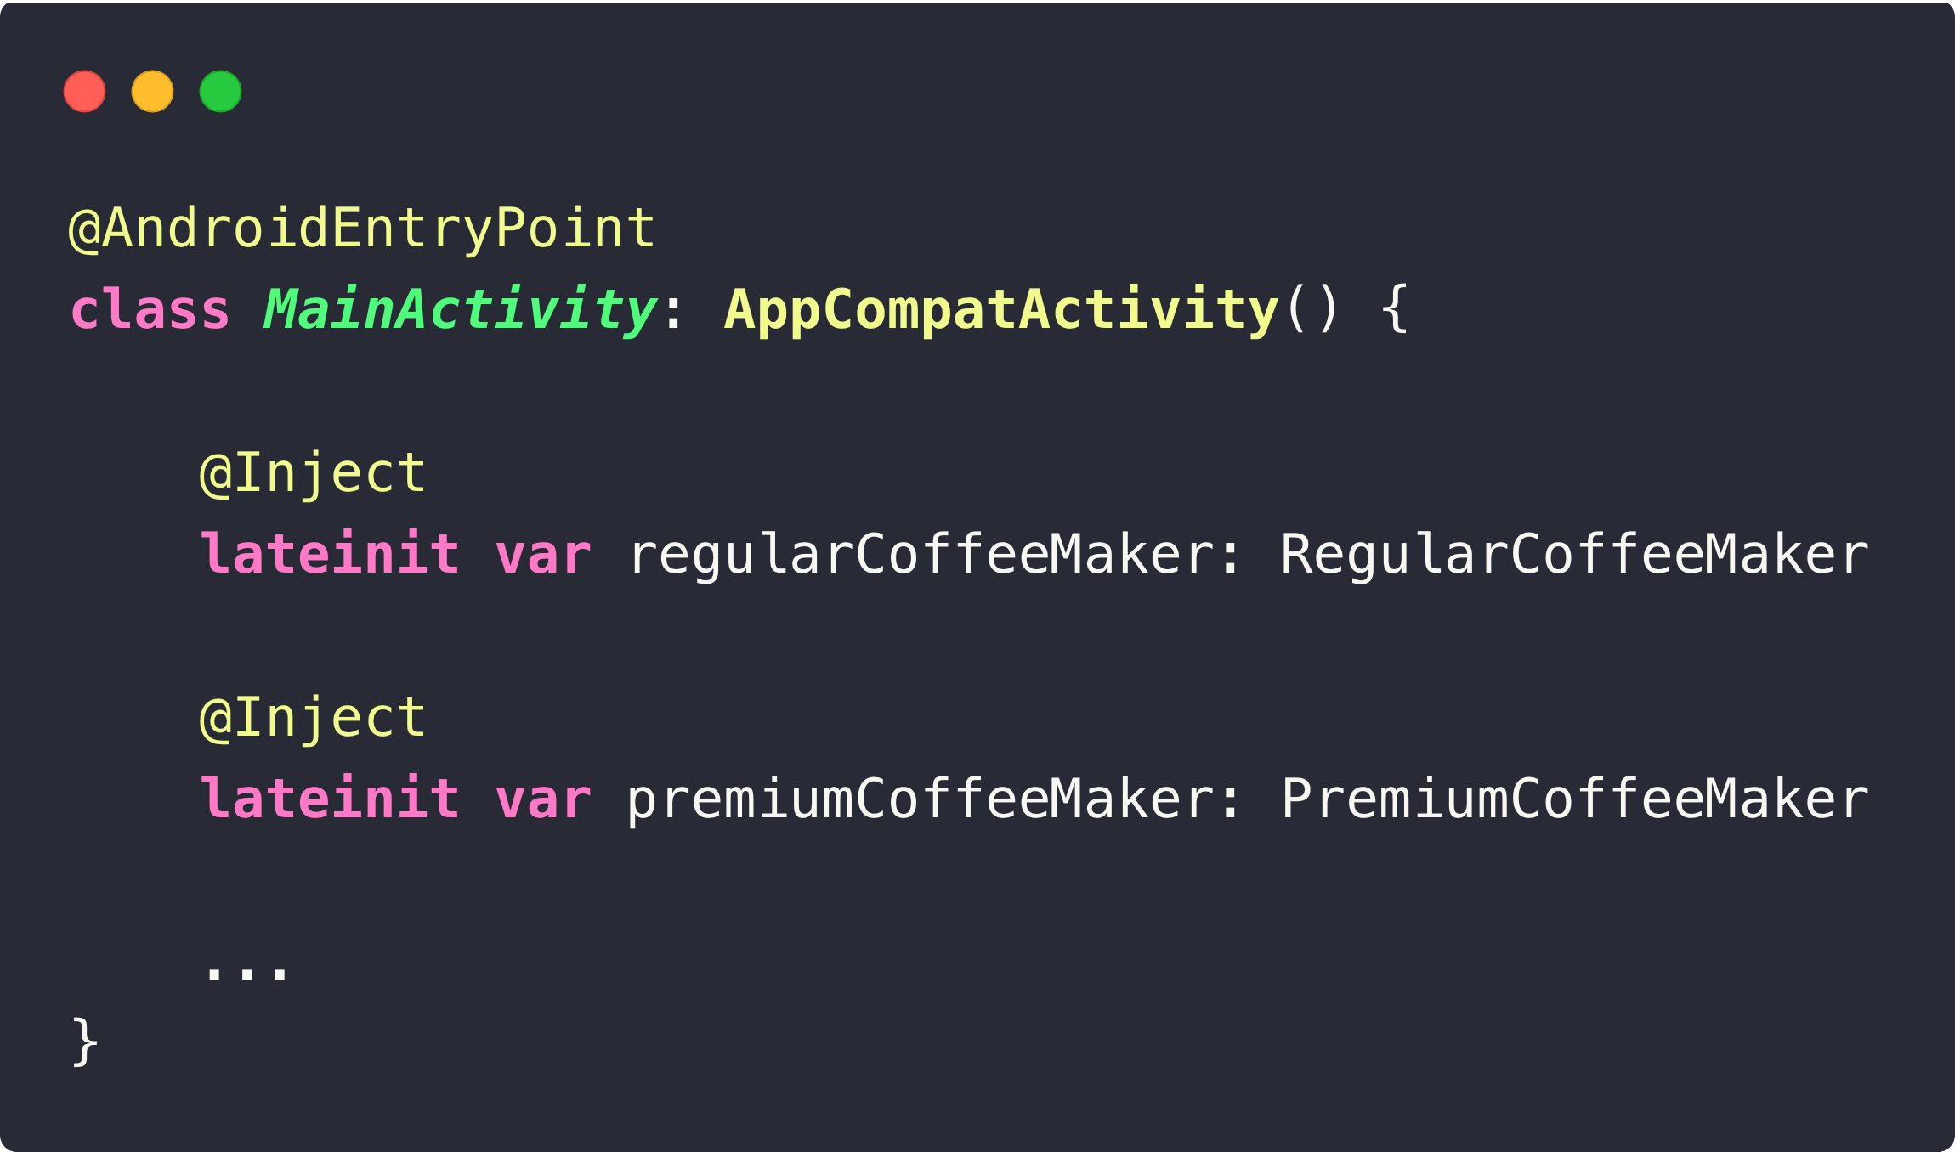
Hilt - Field Injection

Slide 15
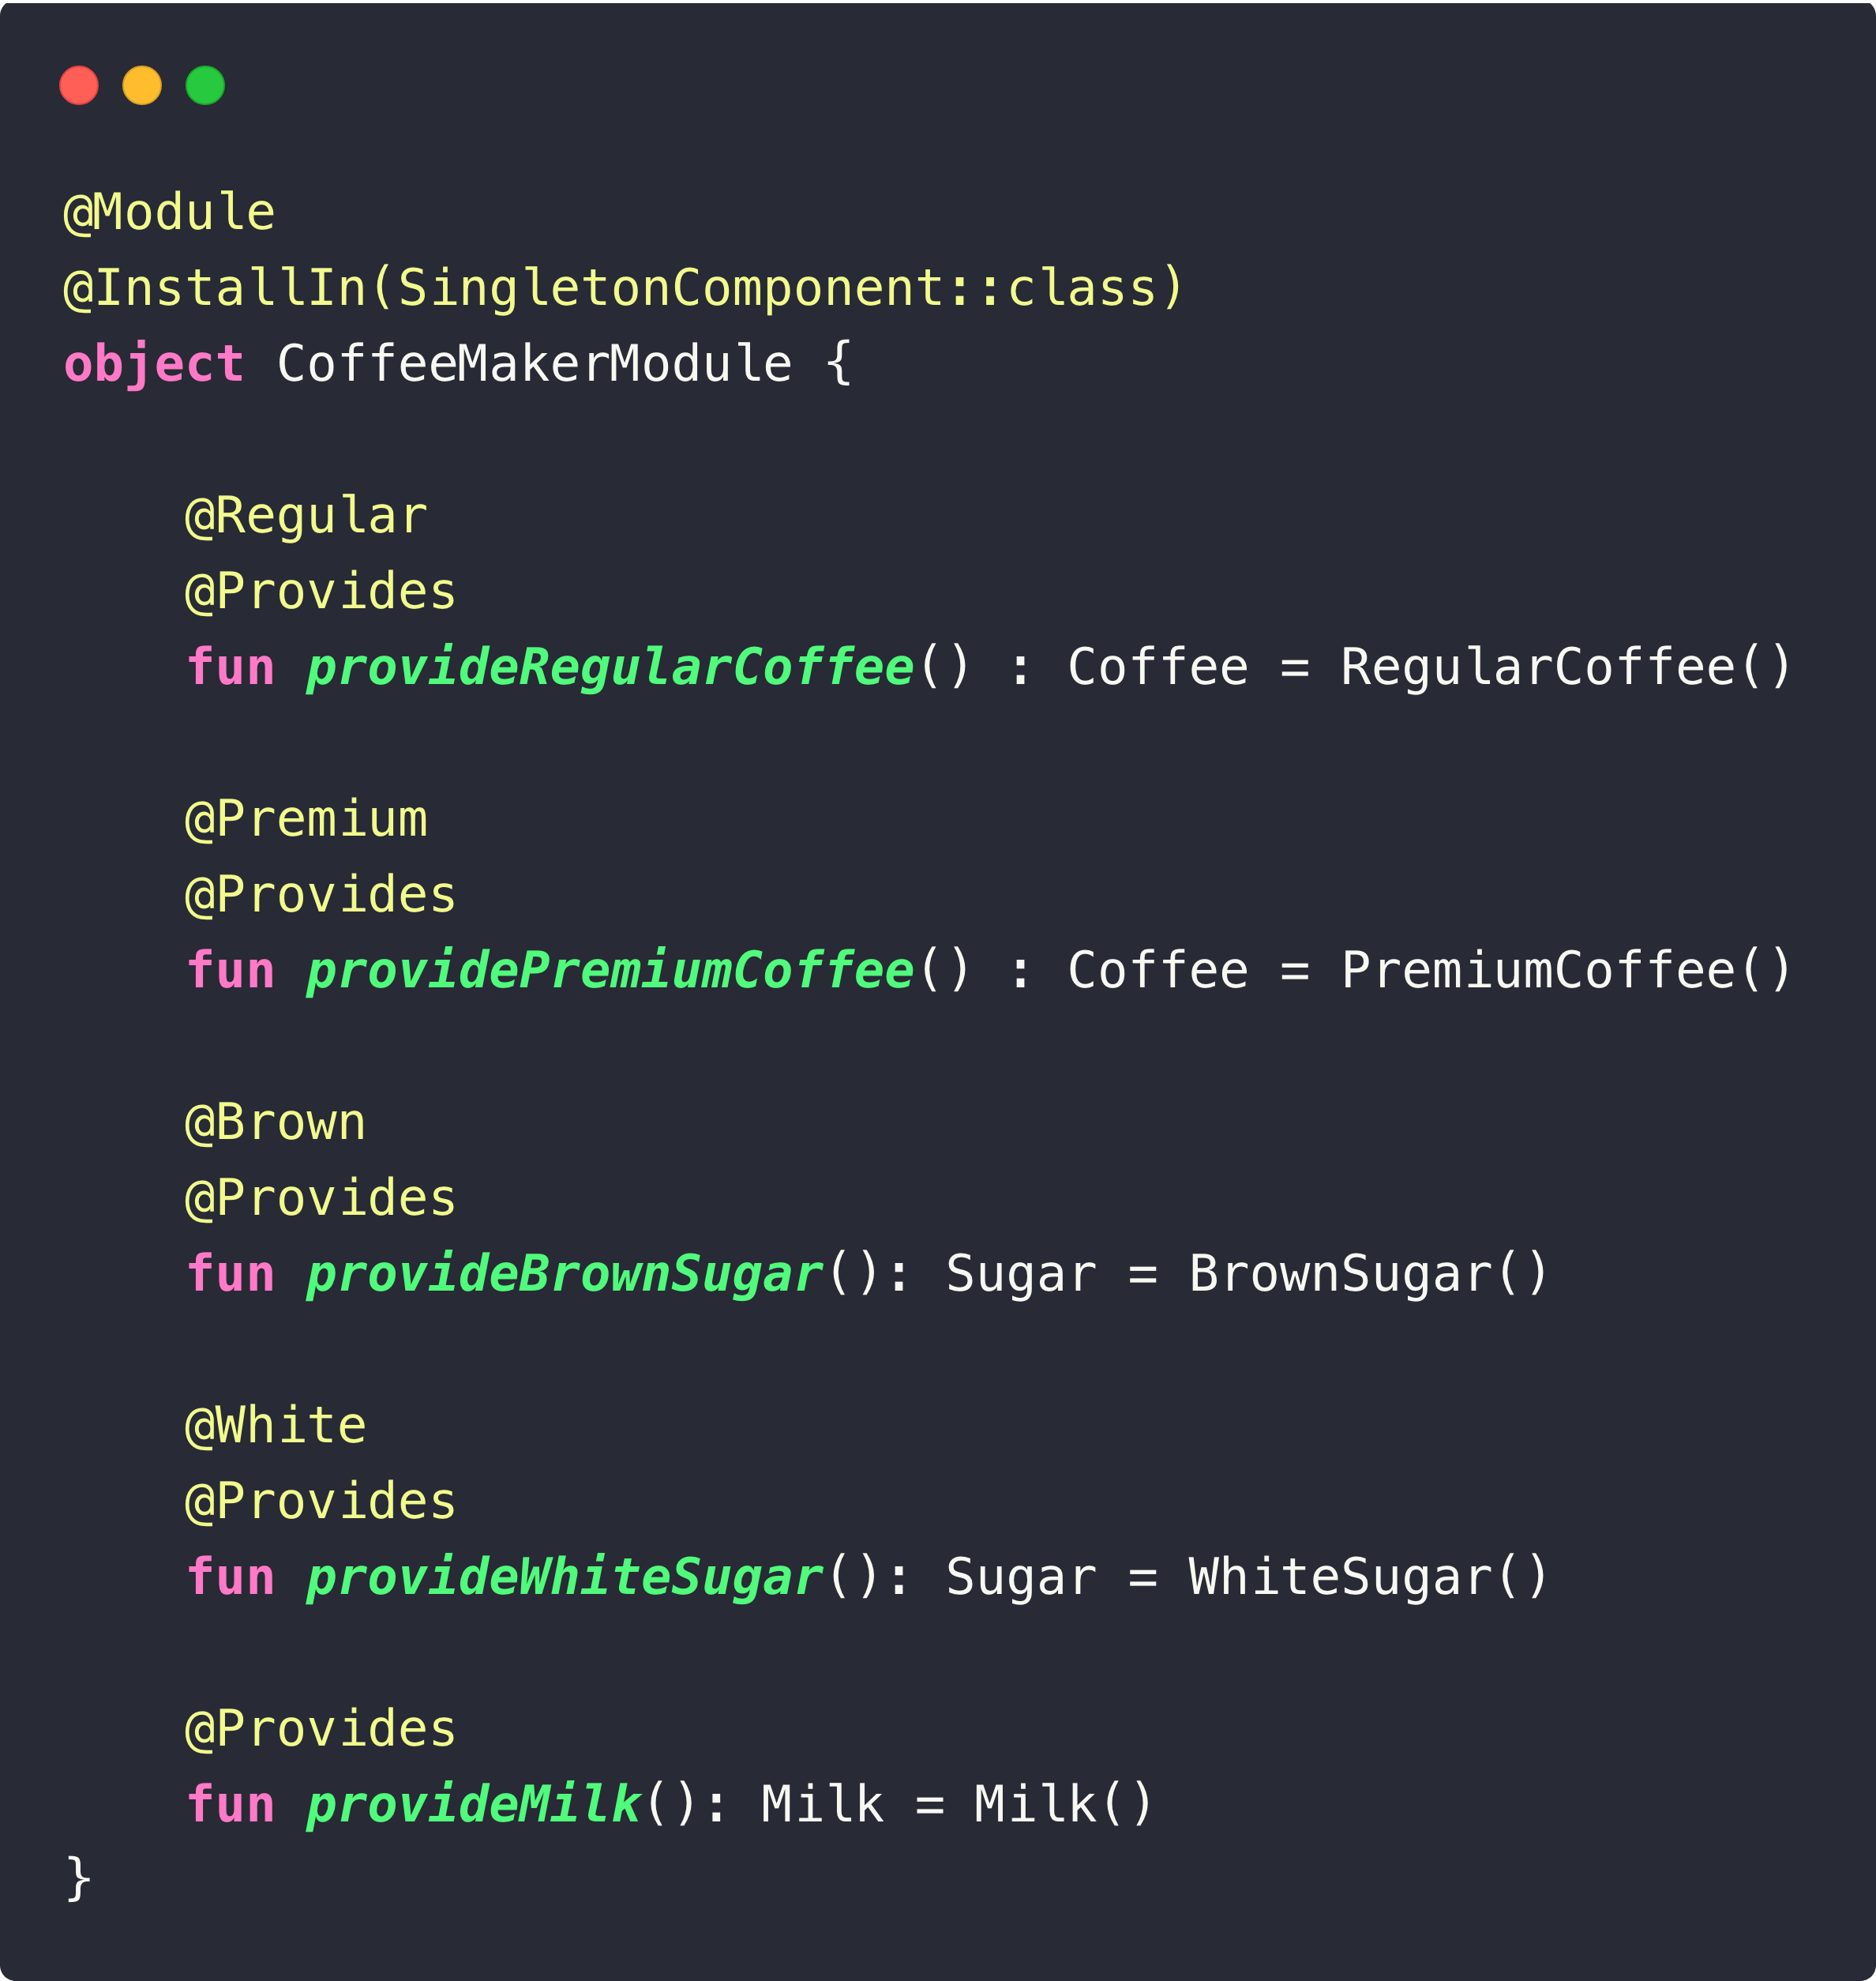
Hilt - Module Basics
Best practice is constructor injection. Sometimes a type cannot be constructor-injected. This can happen for multiple reasons. For example, you cannot constructor-inject an interface. You also cannot constructor-inject a type that you do not own, such as a class from an external library. In these cases, you can provide Hilt with binding information by using Hilt modules.
@Module – Necessary for declare module.
@InstallIn – Indicates which type of components Hilt will inject dependencies in.

Slide 16
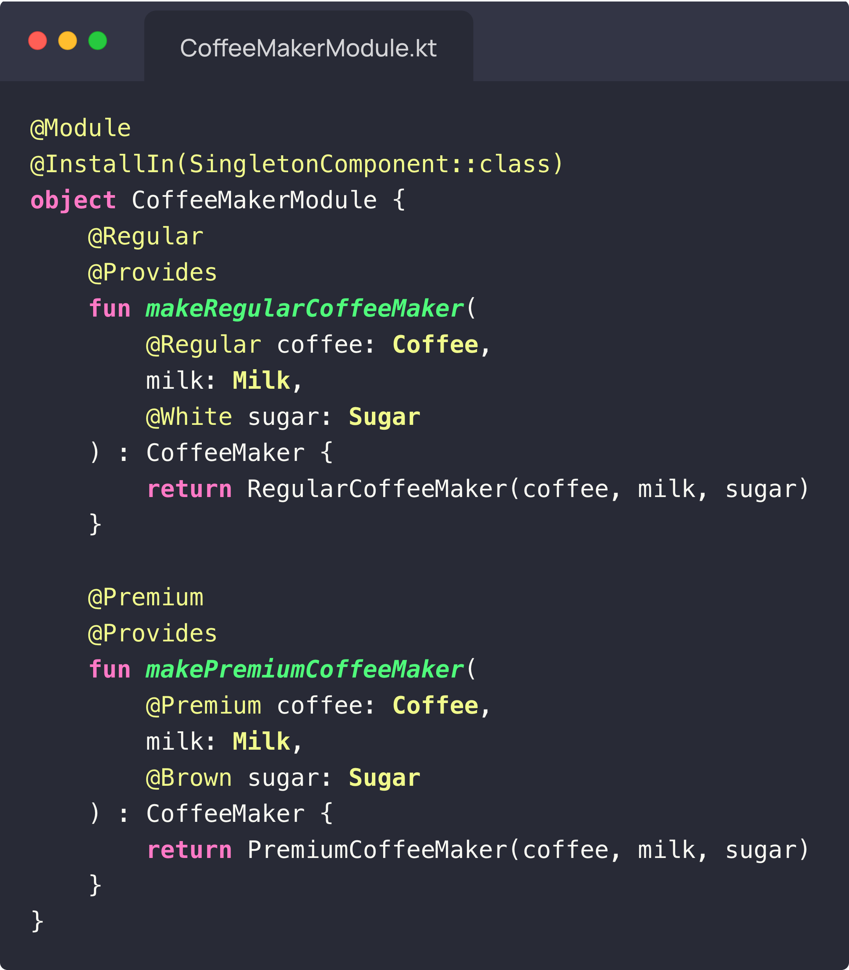
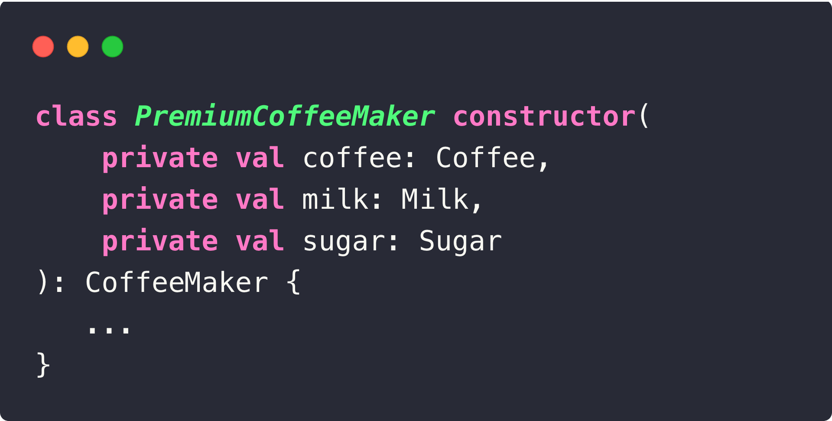
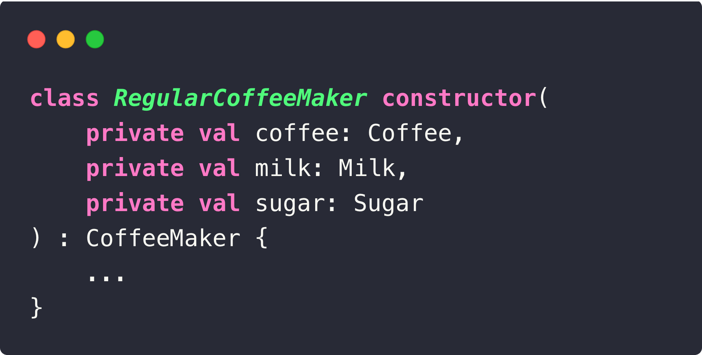
Hilt - Module Basics
Build instance inside module when constructor injection isn’t possible. For example:

Slide 17
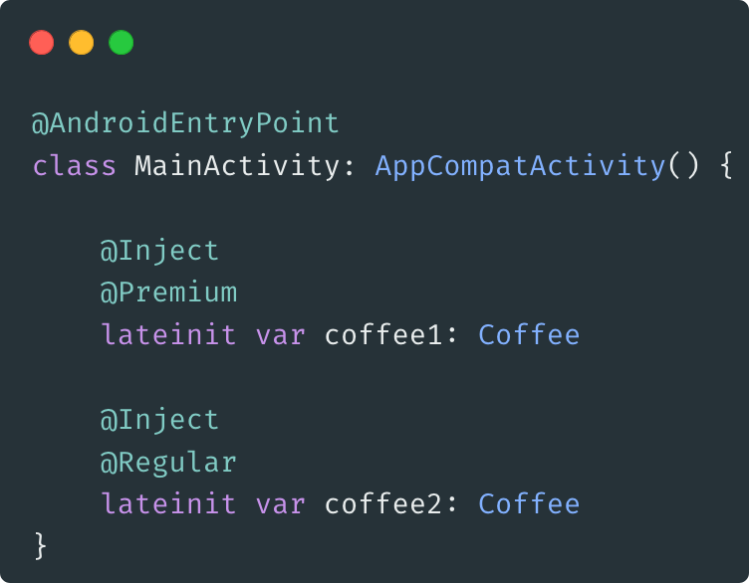
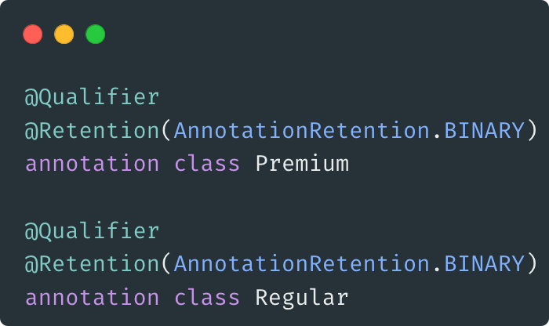
Hilt - @Qualifier
A @Qualifier is an annotation that you use to identify a specific binding for a type when that type has multiple bindings defined.

Slide 18
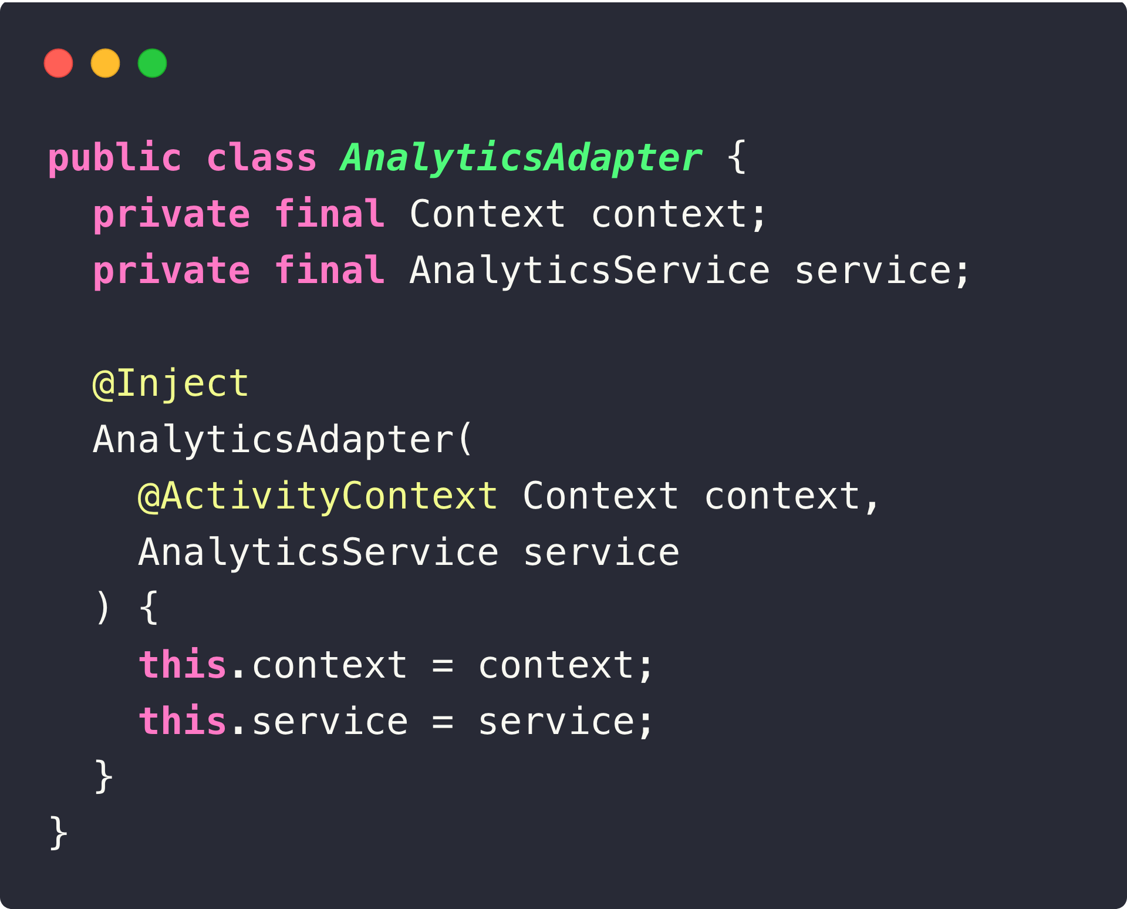
Hilt - Predefined @Qualifier
Hilt provides some predefined qualifiers. @ApplicationContext and @ActivityContext

Slide 19
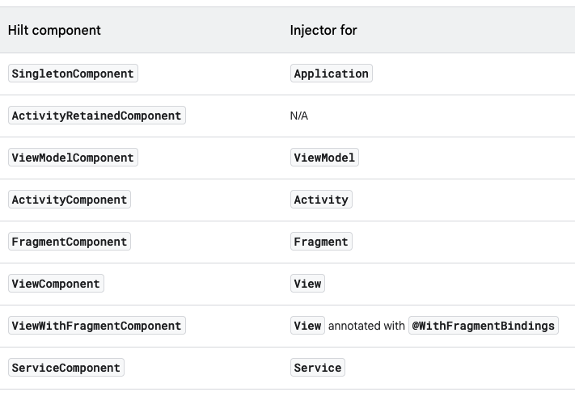
Hilt - Generated components for Android classes
For each Android class in which you can perform field injection, there's an associated Hilt component that you can refer to in the @InstallIn annotation. Each Hilt component is responsible for injecting its bindings into the corresponding Android class.

Slide 20
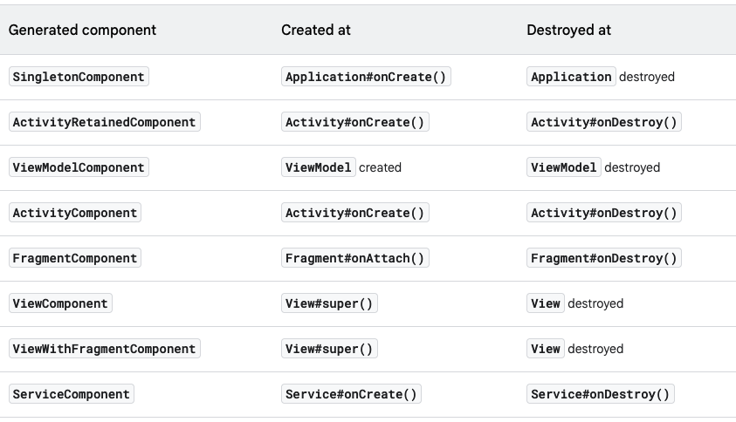
Hilt - Component lifetimes
Hilt automatically creates and destroys instances of generated component classes following the lifecycle of the corresponding Android classes.

Slide 21
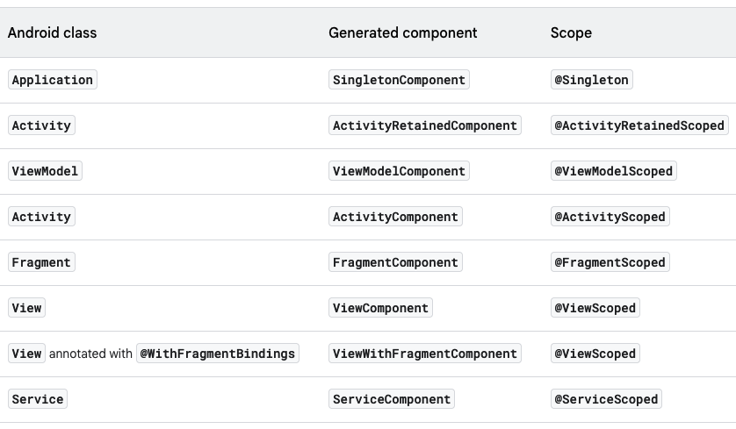
Hilt - Component scopes
By default, all bindings in Hilt are unscoped. This means that each time your app requests the binding, Hilt creates a new instance of the needed type.
However, Hilt also allows a binding to be scoped to a particular component. Hilt only creates a scoped binding once per instance of the component that the binding is scoped to, and all requests for that binding share the same instance.

Slide 22
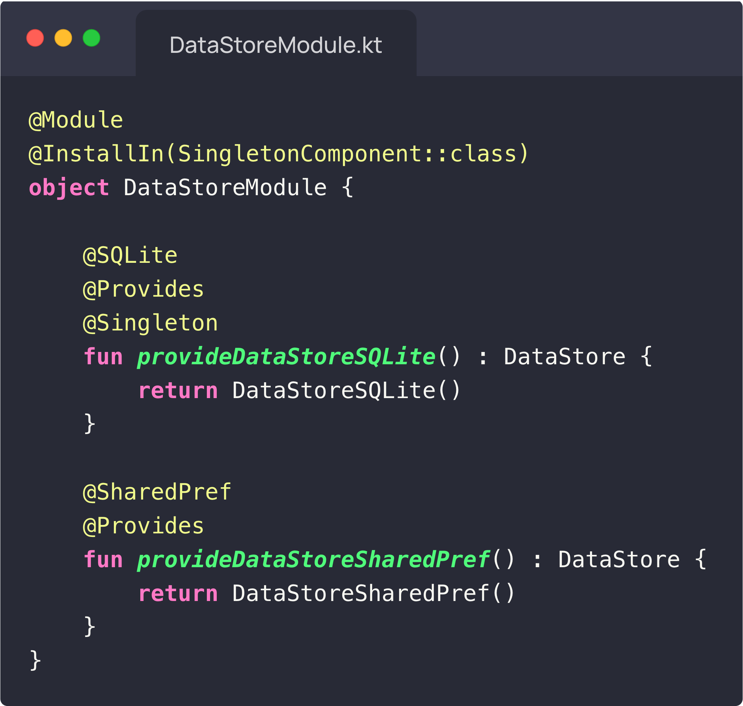
Hilt Example - @Singleton

Slide 23
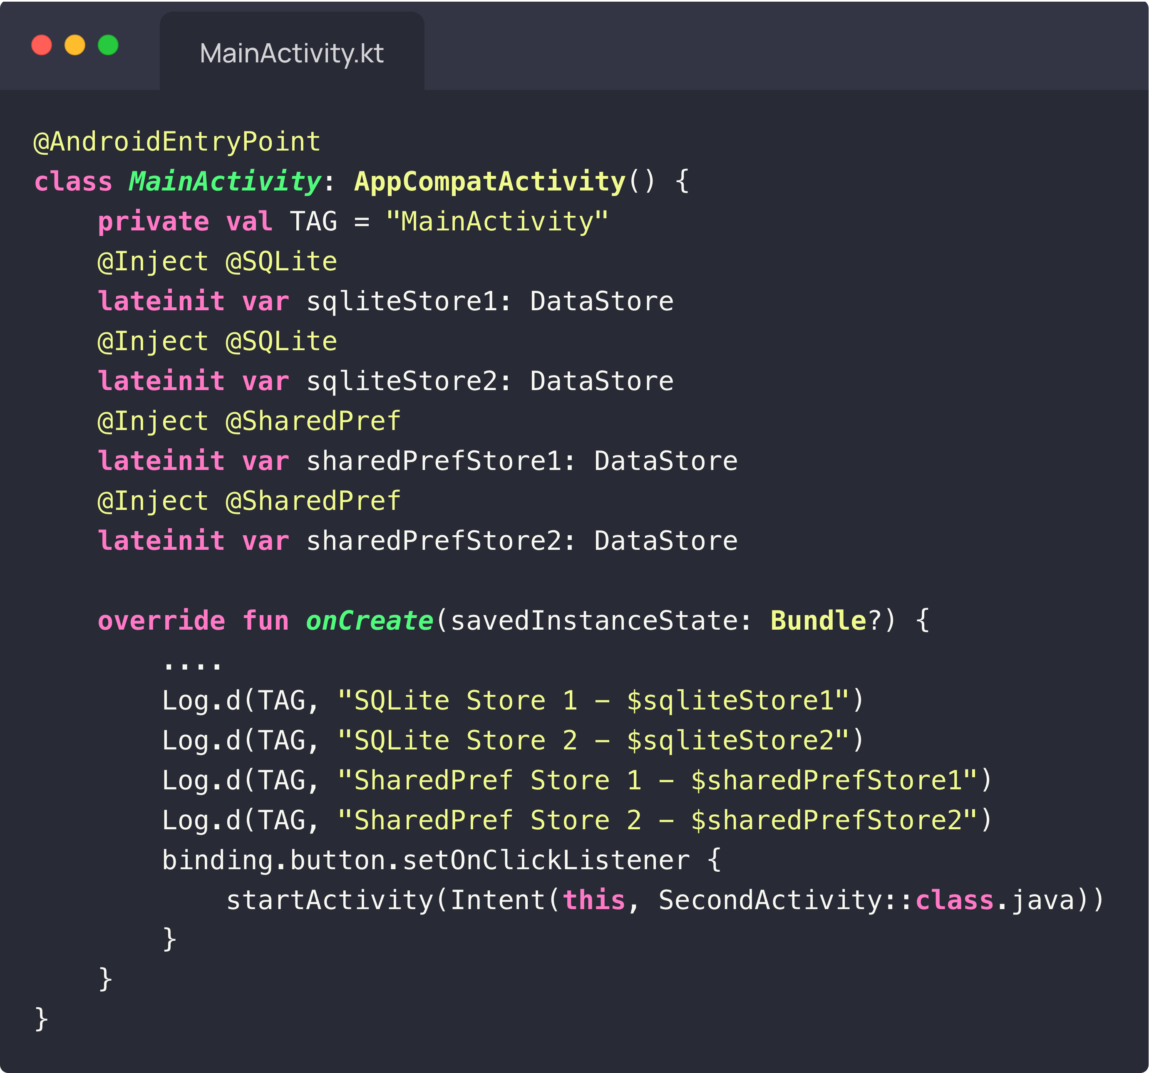
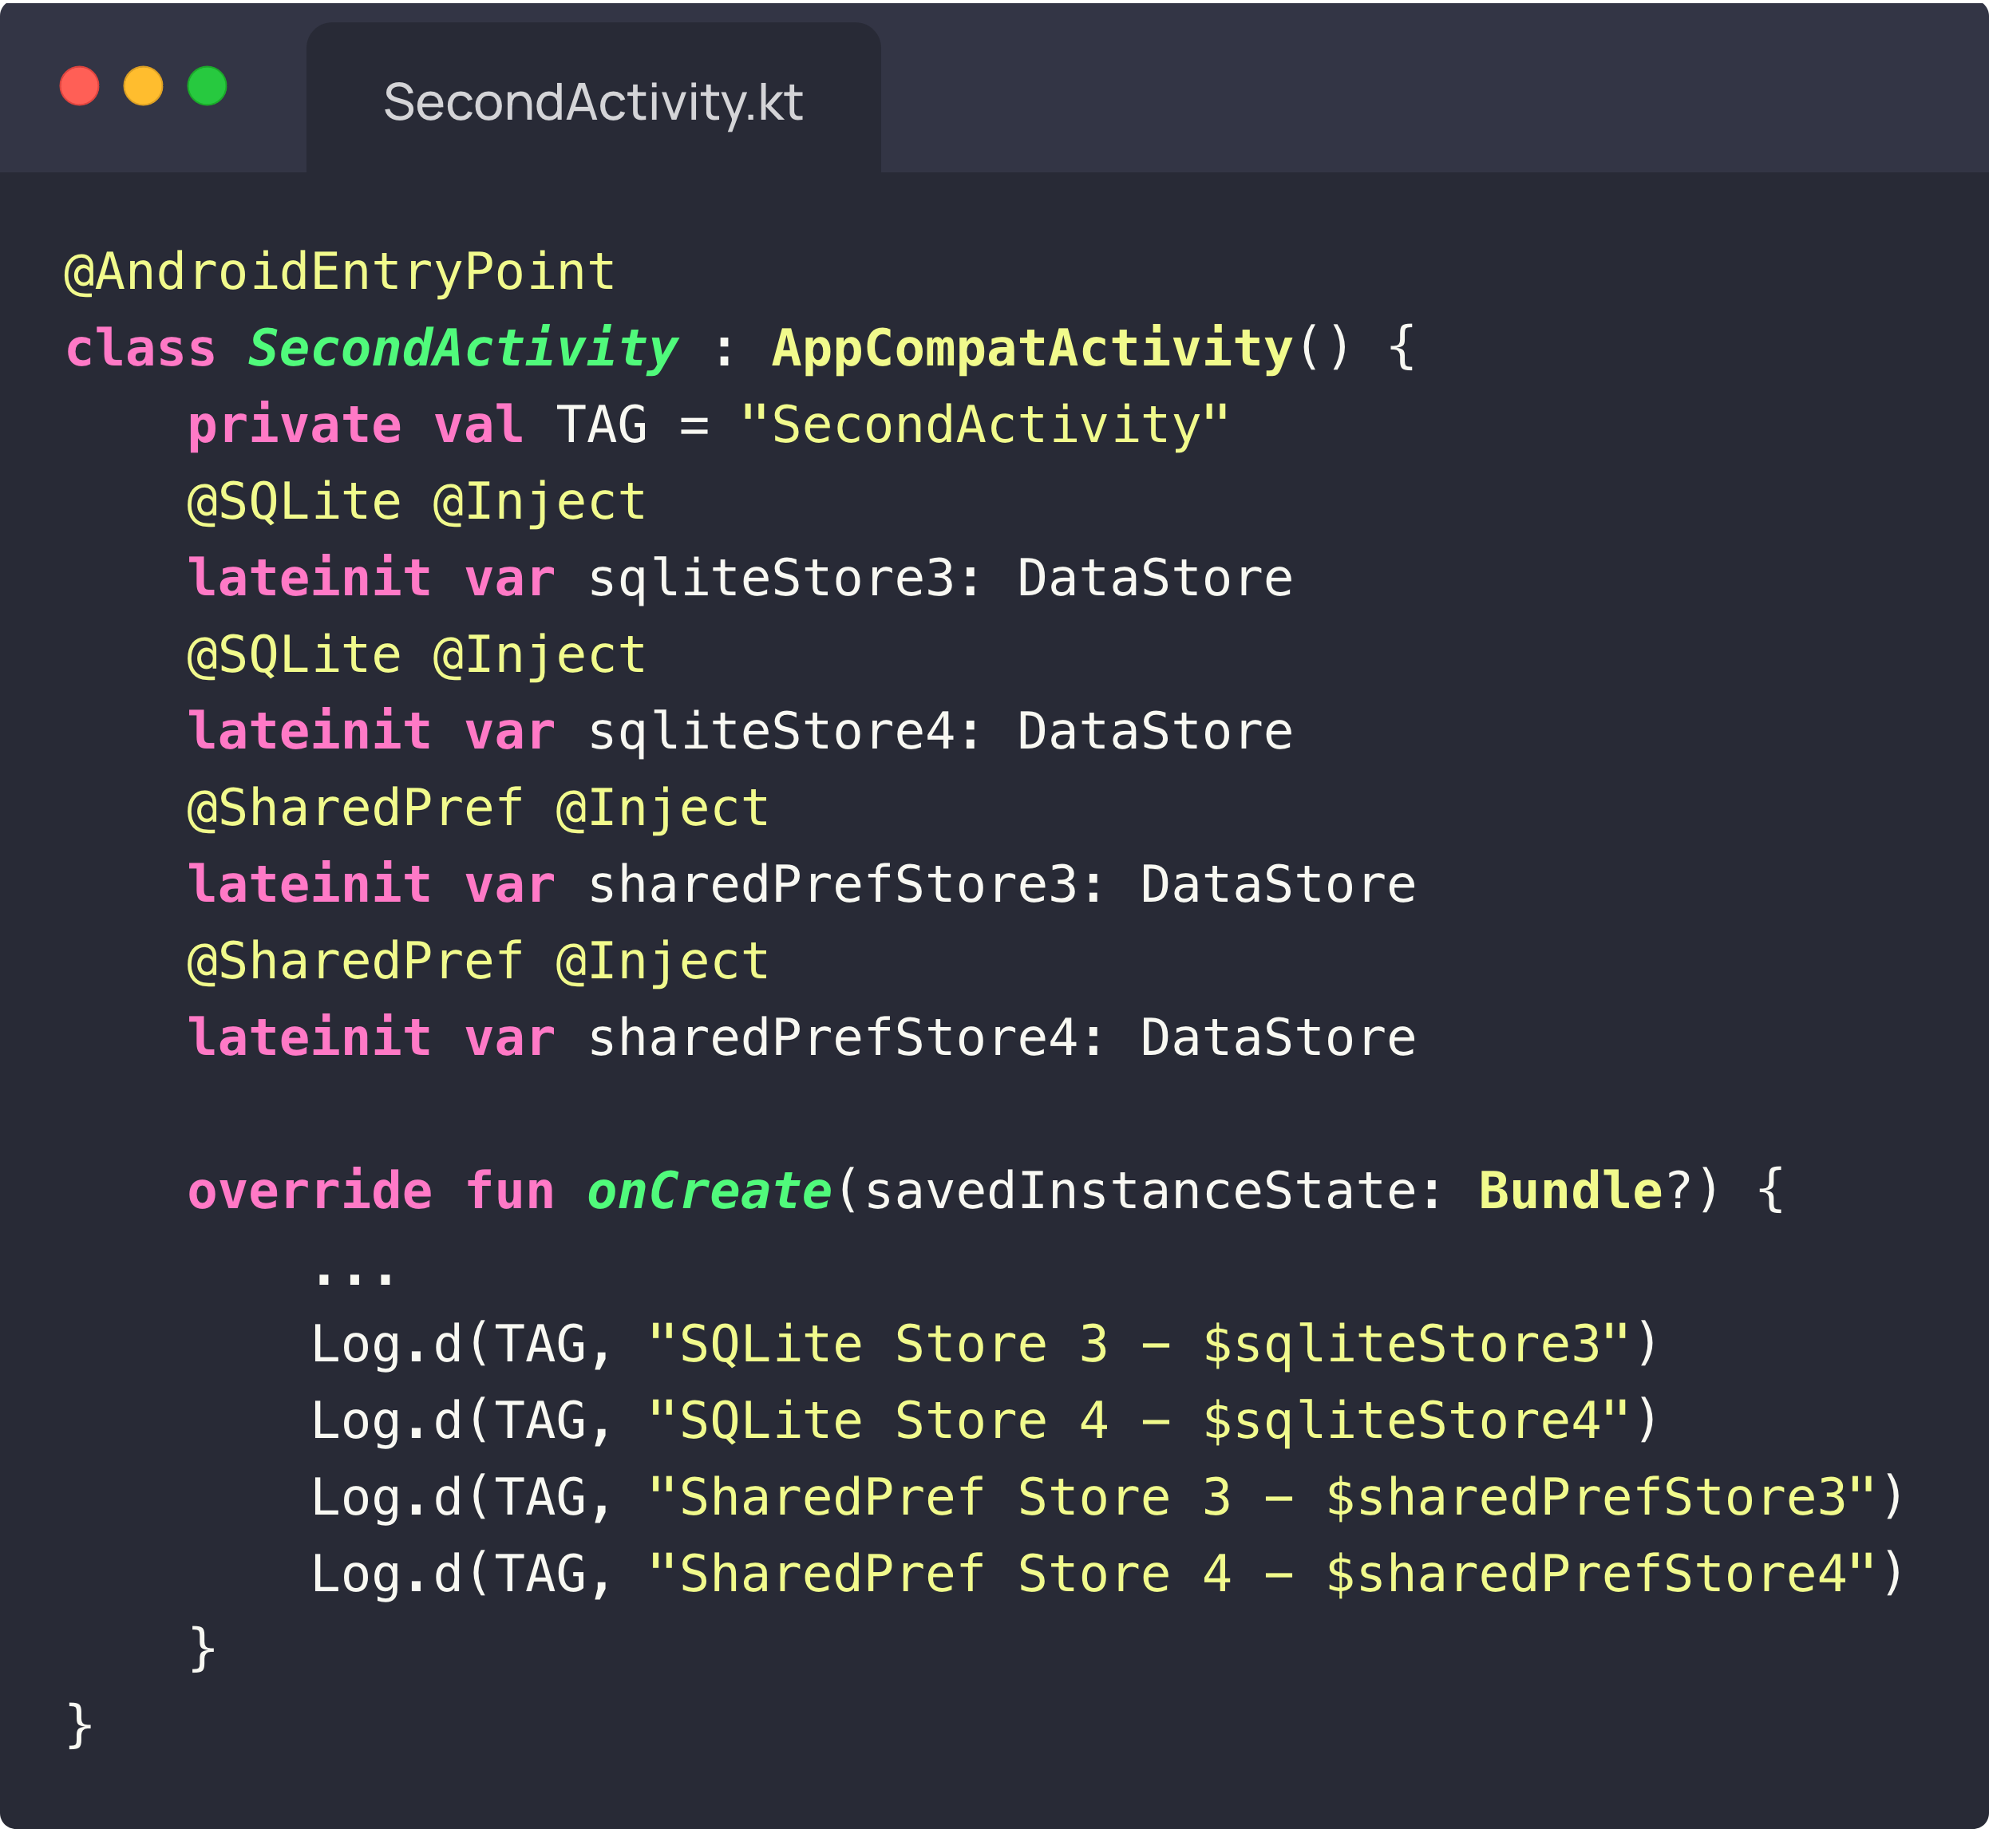
Hilt Example - @Singleton

Slide 24
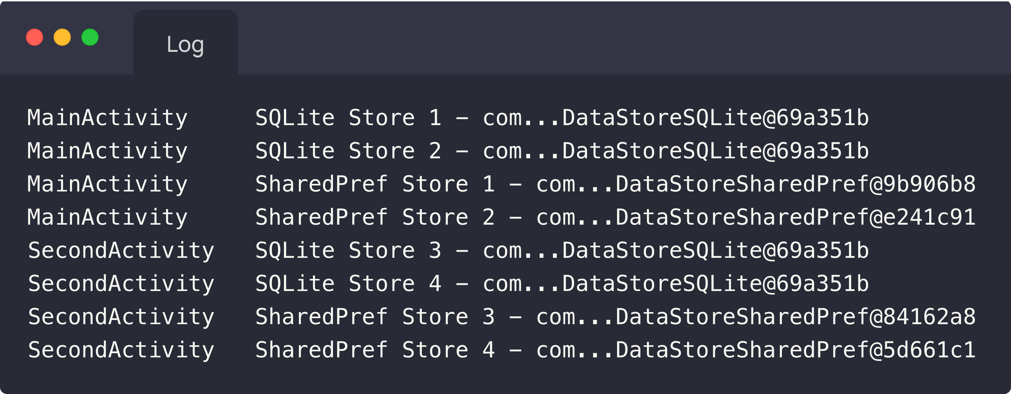
Hilt Example - @Singleton

Slide 25
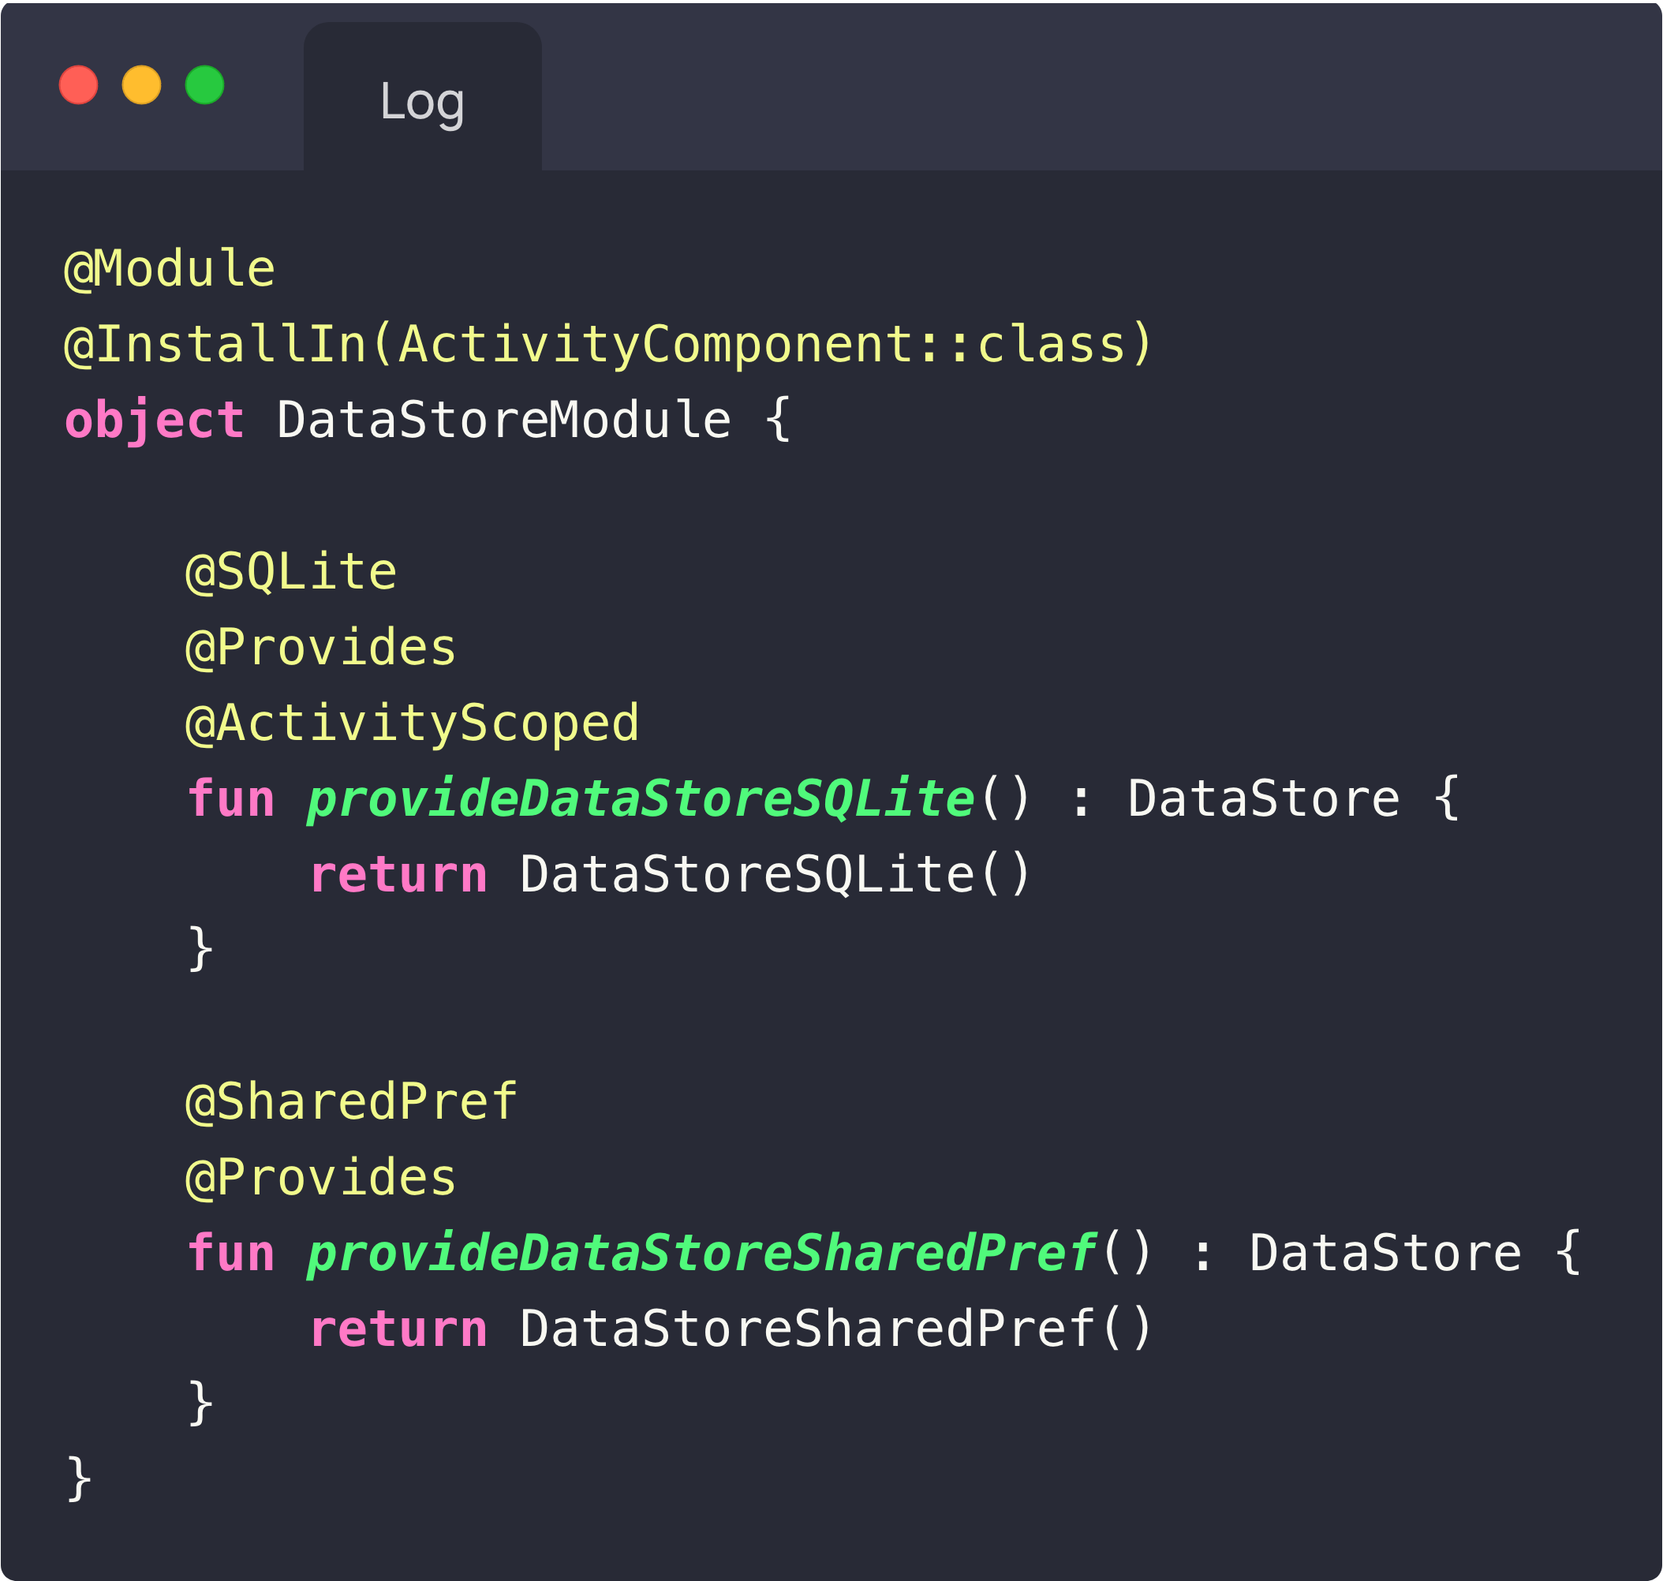
Hilt Example - @ActivityScoped

Slide 26
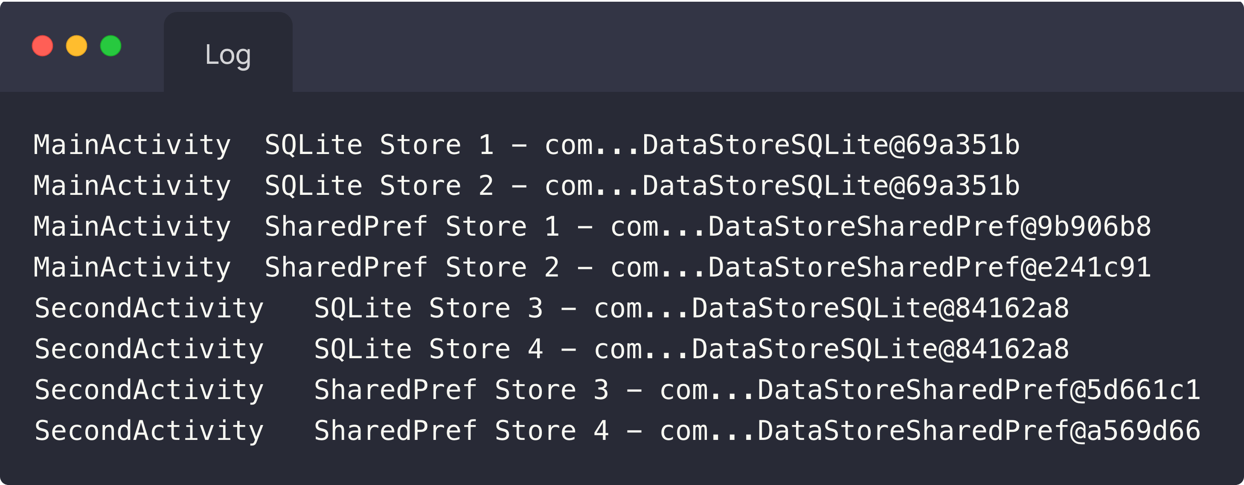
Hilt Example - @ActivityScoped

